Slide 1

International Institute of Professional Studies, Devi Ahilya University
INDORE
Presentation On Notepad Application In Java
Presented By:
Adarsh Yagik
IT-2k17-03

Slide 2
PROJECT OVERVIEW
This project is about designing a simple notepad using the common features provided by java.
Here we can use various operation like cut copy , paste etc.
We can also manages file saving, opening or creating new file.
This project is completely designed over common java features.

Slide 3
AIM OF THE PROJECT
The main aim and reason behind the designing and developing this desktop application, Java primarily based Software project is to provide attractive, user friendly and effective interface to the user over the various operating system.
Where all the users can do their basic staffs like making notes, writings journals, managing docs. Users will have all the options and features in this application like creating new file, saving the existing file, printing the file, copy, paste, cut, selectall the text field.

Slide 4
INTRODUCTION
Notepad is a basic text editor.
It can use to create simple documents. The most common use for Notepad is to view or edit text (.txt) files, but many users find Notepad a simple tool for creating Web pages.
Because Notepad supports only very basic formatting, you cannot accidentally save special formatting in documents that need to remain pure text. This is especially useful when creating HTML documents for a Web page because special characters or other formatting may not appear in your published Web page or may even cause errors

Slide 5
Continue…
Text editor application is a common text-only (plain text) editor. The resulting files—typically saved with the .txt extension—have no format tags or styles, making the program suitable for editing system files that are to be used in a DOS environment.
Easy to use implementation of Shortcut Keys for Basic Editing Functions.

Slide 6
WHY NOTEPAD APPLICATION IN JAVA ?
Java is platform independent Language. It can Run on any Operating System which has JVM installed.
One can not use Windows notepad in other Operating System.
So for Simplify the use of Notepad of Windows in Other Operating System with ease, The Notepad is Developed in Java.
The main objective of this project is to edit or update the text as you want. It acts like as windows notepad so having all of the function of it. Thus it makes a very important role in the Text Editing.

Slide 7
BASIC FEATURES
New File –User can save the existing files and can create new files.
File open – User can either open the files already existing in the system or open a new blank file.
Files save - one can save the file in any desired format like-.txt, .doc, .java etc. The file is stored in the location specified by the user.
File print –User can easily print their files.
Cut-Copy-Paste – This editor also lets the user cut-copy-paste the edited text.
SelectAll – User can select all the text written in the text field from here.
About The Notepad- Here user will get basic information of the notepad.

Slide 8
WORKING MODEL
Display blank
Page with file
Editing options
Includes different
Cases & functions
For handling the
Files.
MAIN FUNCTION
TYPING FUNCTION
Calls starting
Function during
File handling
STARTING FUNCTION
BEING CALLED
FILE HANDLING
CREATING NEW FILE
WRITING FILE
READING FILE

Slide 9
SYSTEM DEVELOPMENT LIFE CYCLE
System Analysis
Software Requirement Analysis
Software Analysis And Design
Code Generation
Maintenance

Slide 10
SYSTEM ANALYSIS
As software work begins by establishing requirements for all system elements and then allocating some subset of these requirements to software. This system view is essential when software must interface with other elements such as hardware, people and other resources. System is the basic and very critical requirement for the existence of software in any entity
Basic Hardware Configuration Requirement;
Console : - Mouse, Monitor, Keyboard.
Processor : - Intel Celeron or higher, Amd apu dual core
or higher
RAM : - 1Gb RAM
ROM : - 64 Gb

Slide 11
SYSTEM REQUIREMENTS ANALYSIS
Computer with any Operating System.
Java Installed Platform.
1GB RAM
64GB ROM
Language: English

Slide 12
SOFTWARE ANALYSIS AND DESIGN
Basic core Java is used in this system include, Multithreaded programming, Method Overriding, File Handling for saving, opening and printing file.
The default package to build any program in Java is lang that is used in developing this system
The API to build Graphical User Interface in Java is provided using the packages awt and swing. This system uses both the packages to provide GUI based forms.
The streams that are used to write and read the data over system are also utilized in this system, which are in the package of io.

Slide 13
CODE GENERATION
Importing the inbuilt Java libraries.
Declaring the variables.
Designing the Notepad interface.
Adding listeners for tracking various
Events of the Notepad.
Handling of text editing events.
Creating Executable jar file.

Slide 14
MAINTENANACE
Update Required :
It should have the ability to Search and Replace Text.
A file should be locked with password protection.
Colorful Text would also be entered in notepad.
Word wrap option to be added.
Size Limitation Should be removed.
Theme option should be there for attractive interface.

Slide 15
ARCHITECTURE OF NOTEPAD APPLICATION
The main menu bar of the Notepad application consists of three pull down menus:
NOTEPAD APPLICATION
File Menu
Edit Menu
About Menu

Slide 16
ARCHITECTURE OF FILE MENU MODULE
FILE MENU
New Option
Open Option
Save Option
Print
Option
Exit Option

Slide 17
ARCHITECTURE OF EDIT MENU MODULE
EDIT MENU
Copy Option
Paste Option
Cut Option
SelectAll
Option

Slide 18
ARCHITECTURE OF ABOUT MENU MODULE
About MENU
About The Notepad

Slide 19
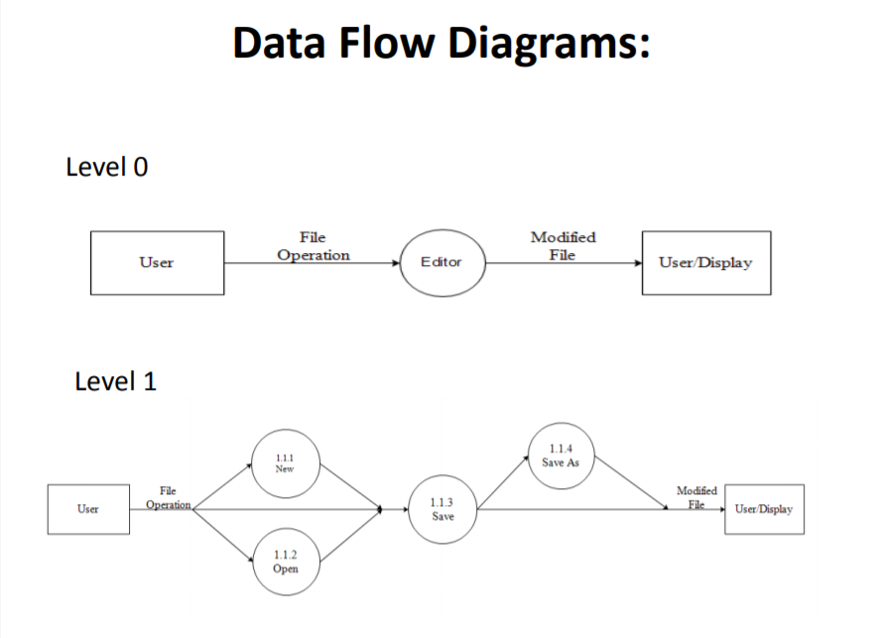
Data Flow Diagram

Slide 20

THANK YOU

